Slide 1
Student Leadership in the Digital World
11 Tips for Encouraging Online Engagement
— and Civility

Slide 2
Likes ≠ Leadership

Slide 3
Goals
Build an audience
Support MEANINGFUL engagement
Encourage civility

Slide 4
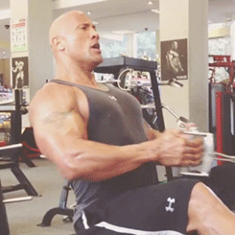
Focus.
Notes:
How many of you have more than one social account you check daily? How many have more than 3?

Slide 5
Conduct research on where your audience is
Evaluate the context
Consider your content — and your strengths
Choose one or two channels to focus on
The average internet user has 8.4 social media accounts (source: Hootsuite)
Notes:
How many of you have more than one social account you check daily? How many have more than 3?

Slide 6
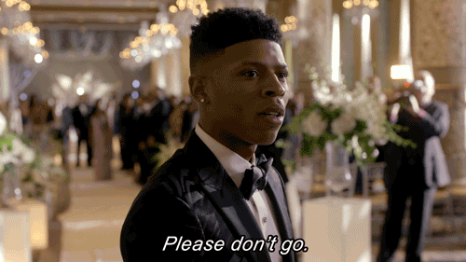
2. Stay Put.
Notes:
How many of you have more than one social account you check daily? How many have more than 3?

Slide 7
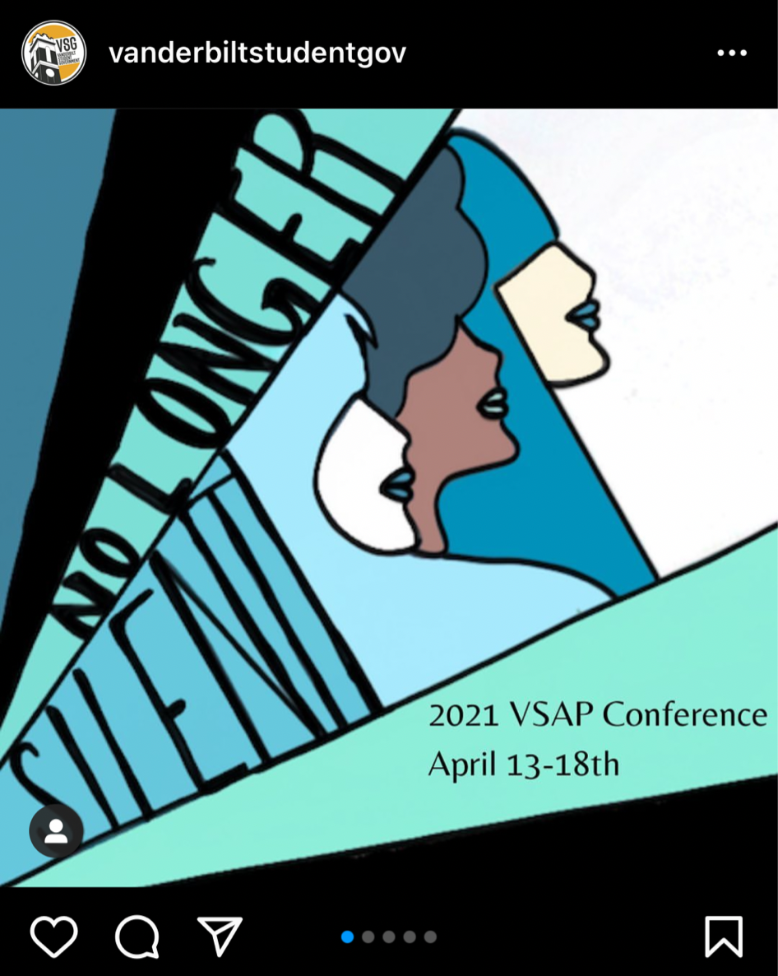
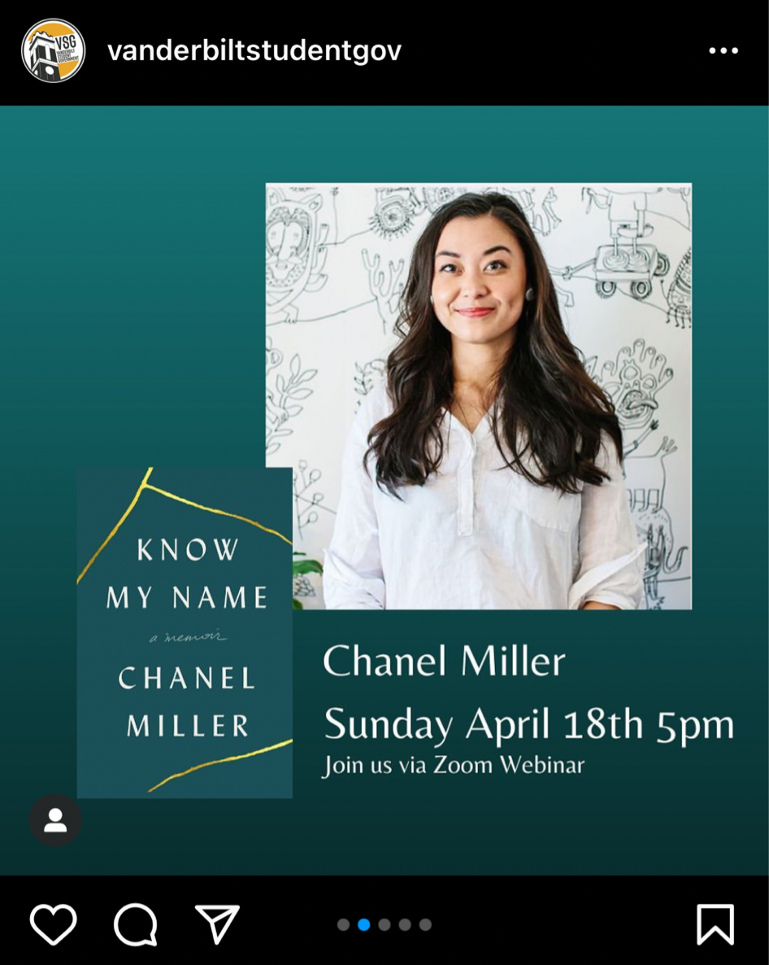

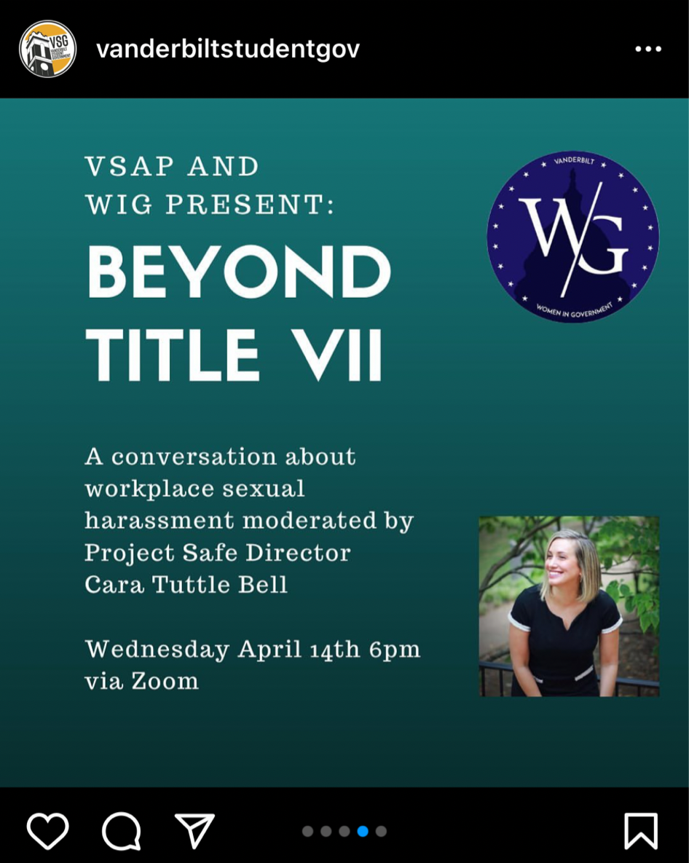
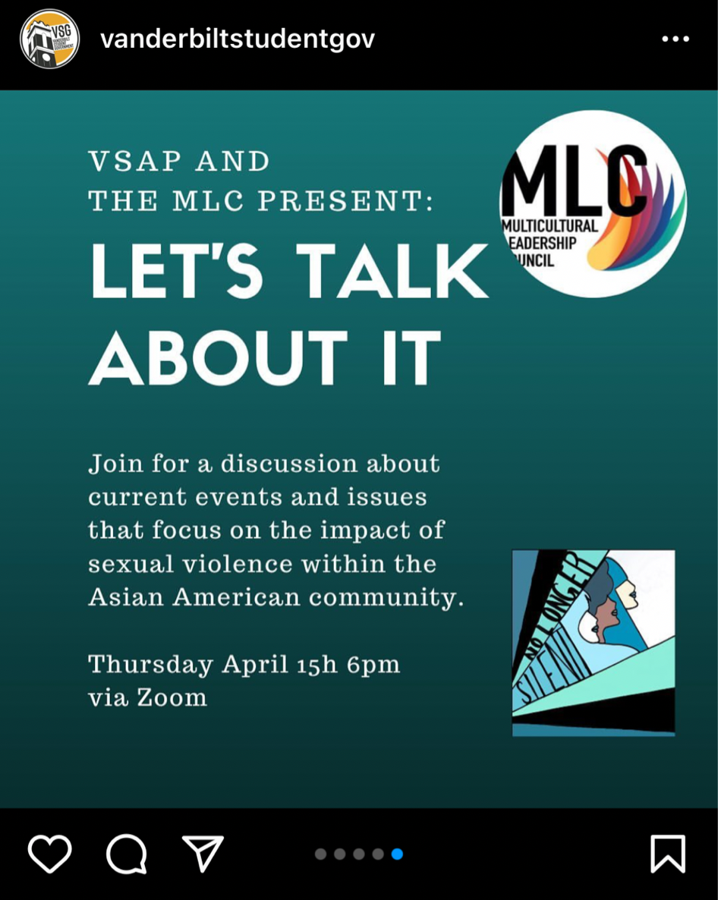
Upload videos and photos instead of embedding
Don’t include links unless absolutely necessary
Adjust the content to the platform
= Algorithm boost
Notes:
How many of you have more than one social account you check daily? How many have more than 3?

Slide 8
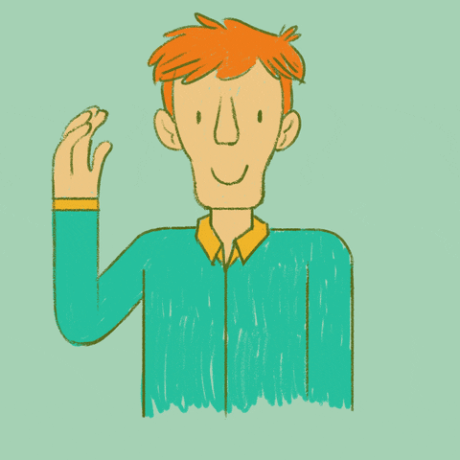
3. Be human.
Notes:
How many of you have more than one social account you check daily? How many have more than 3?

Slide 9
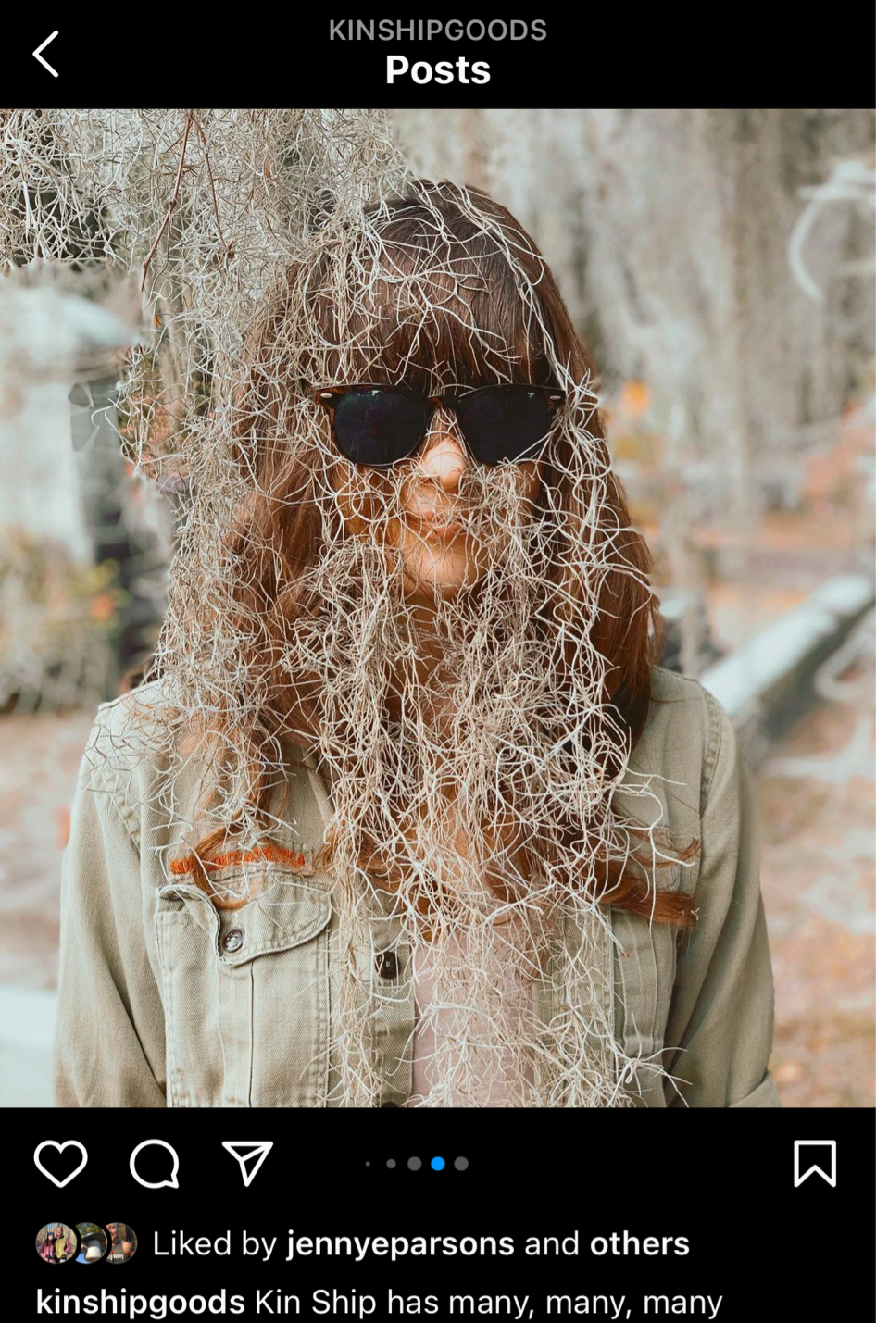
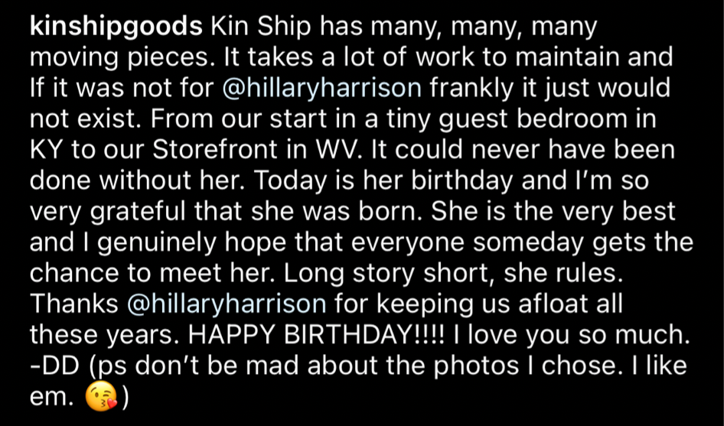
Incorporate videos and photos
“Sign” posts when appropriate
Loosen up
Be authentic
Notes:
How many of you have more than one social account you check daily? How many have more than 3?

Slide 10
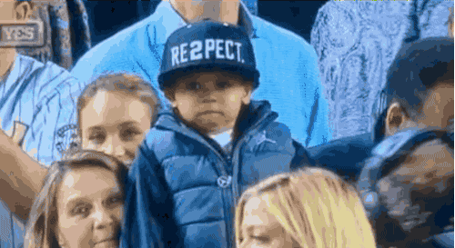
4. Show Love.
Notes:
How many of you have more than one social account you check daily? How many have more than 3?

Slide 11
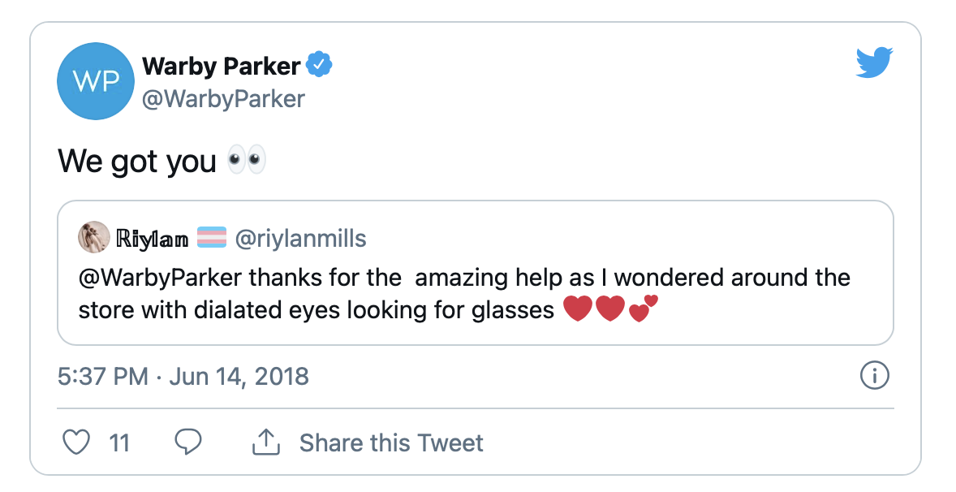
Mention or tag others.
Respond to positives and negatives.
Like, share, or comment on others’ content.
Notes:
Respond to positives too!!!!!

Slide 12

5. Be Inclusive.
Notes:
How many of you have more than one social account you check daily? How many have more than 3?

Slide 13
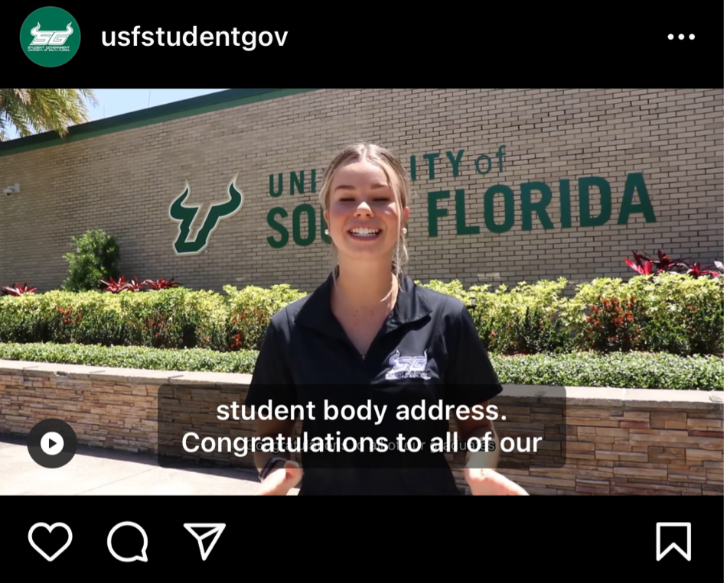
Upload or create captions. You can purchase “burned in” captions at Rev.com.
Include transcripts
Include alt text
Include people with diverse experiences and backgrounds
Notes:
How many of you have more than one social account you check daily? How many have more than 3?

Slide 14

6. Be Transparent.
Notes:
How many of you have more than one social account you check daily? How many have more than 3?

Slide 15
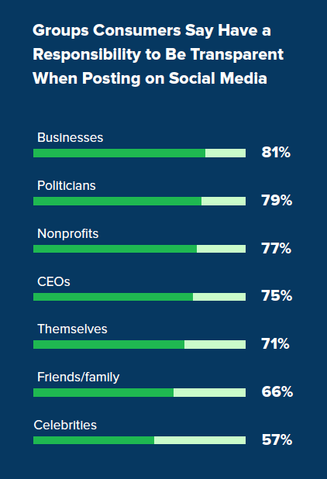
Show “behind the scenes.”
Explain the process — particularly decision-making.
Don’t shy away from vulnerability.
Be honest, and admit faults or imperfections.
https://www.commercialwebservices.com/blog/2018/10/11/why-social-media-transparency-leads-to-customer-trust/
Notes:
How many of you have more than one social account you check daily? How many have more than 3?

Slide 16
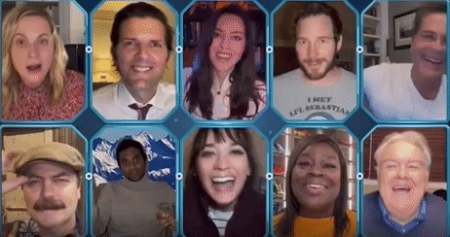
7. Go Live.
Notes:
How many of you have more than one social account you check daily? How many have more than 3?

Slide 17
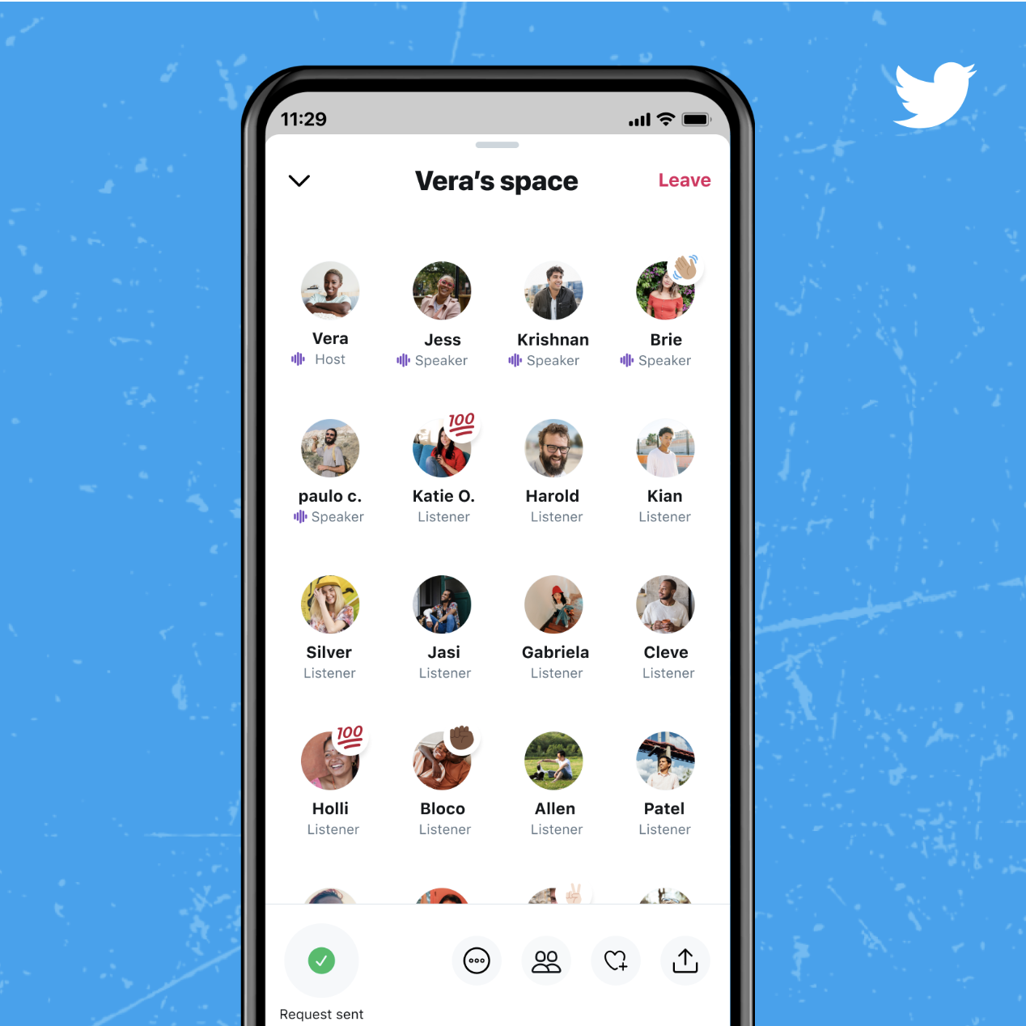
Promote your live event extensively in advance.
Encourage and answer questions. If appropriate, credit or acknowledge online participants.
Share recordings after the live event.
Notes:
How many of you have more than one social account you check daily? How many have more than 3?

Slide 18
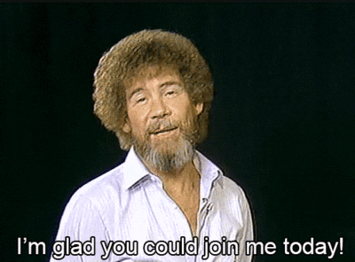
8. Go Hybrid.
Notes:
How many of you have more than one social account you check daily? How many have more than 3?

Slide 19
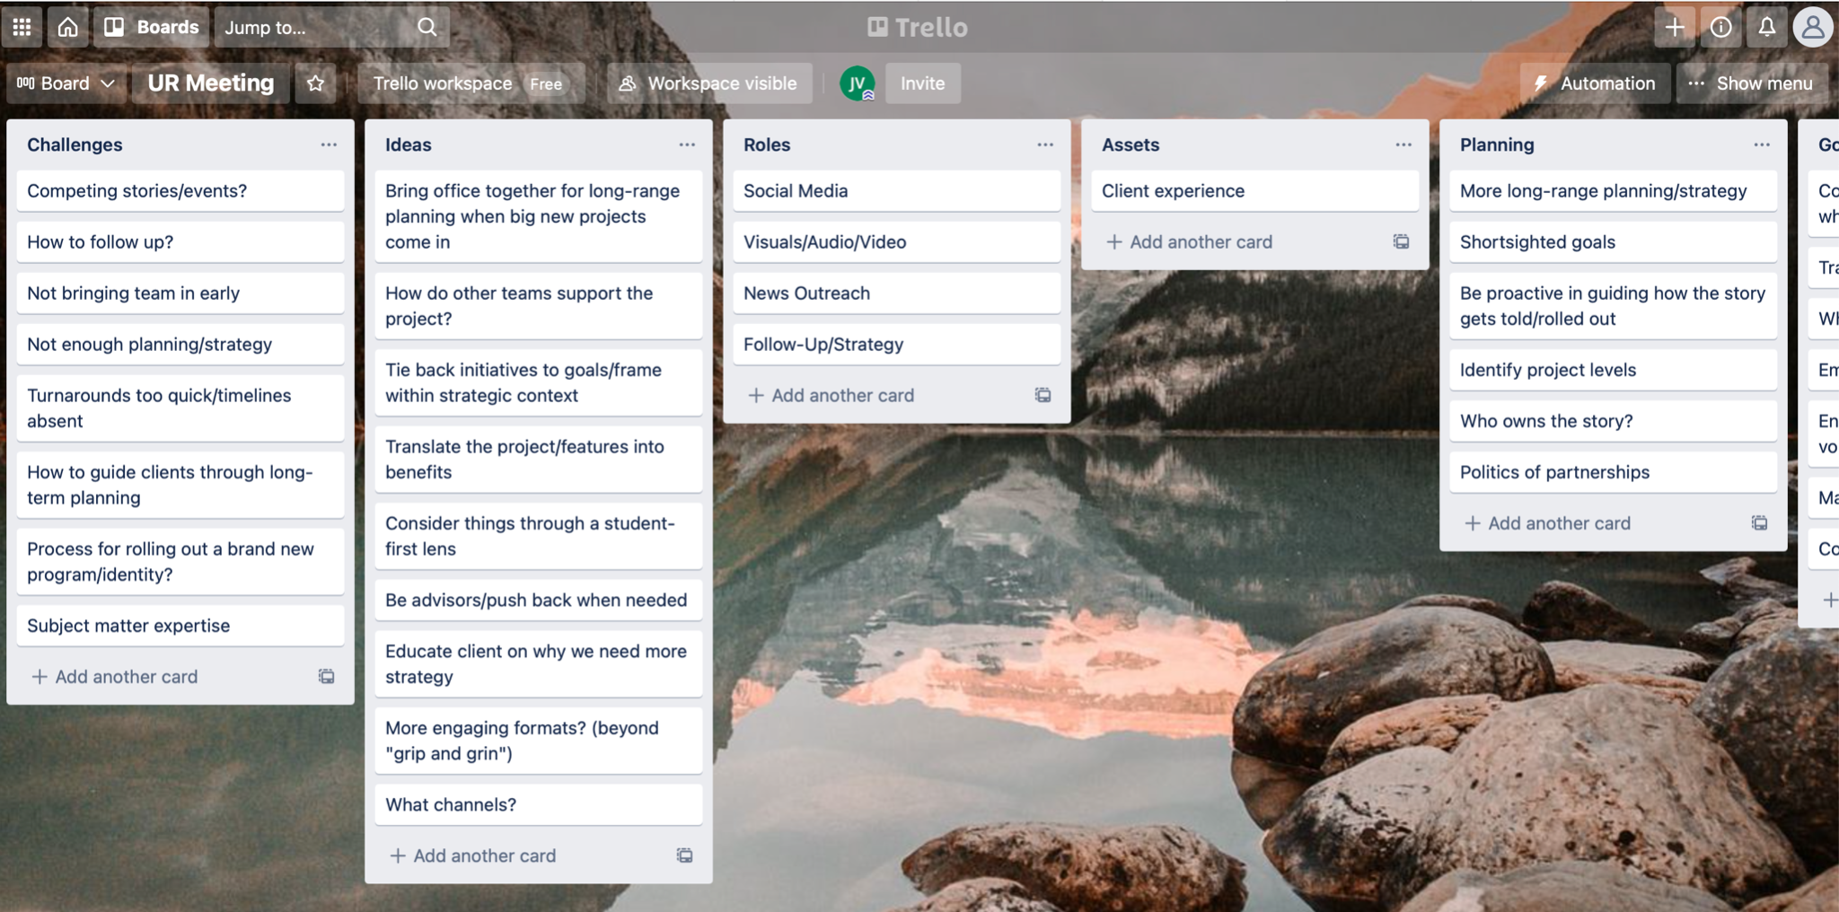
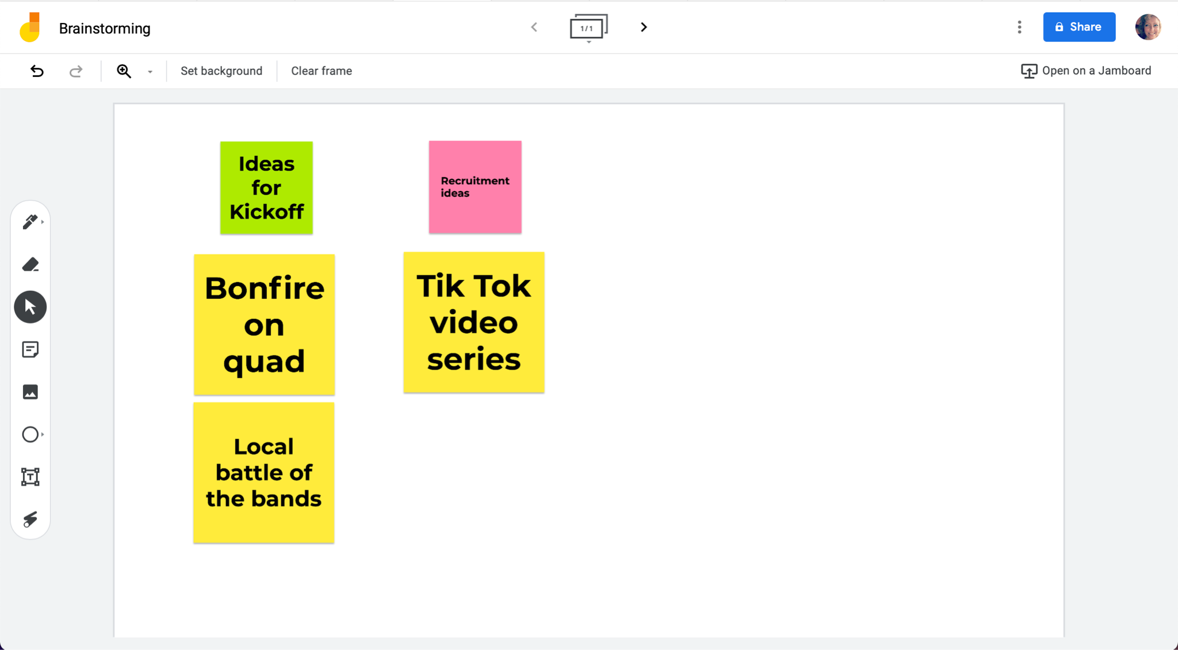
Don’t forget those online.
If possible, give folks online a live visual — and something to do.
Connect online and live participants.
Notes:
How many of you have more than one social account you check daily? How many have more than 3?

Slide 20
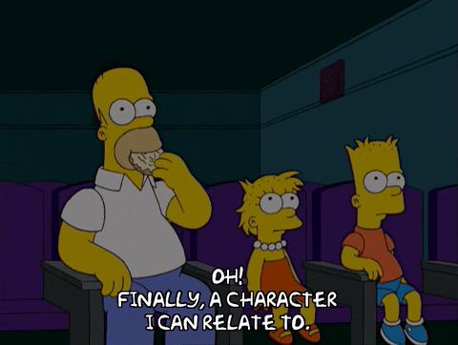
9. Relate.
Notes:
How many of you have more than one social account you check daily? How many have more than 3?

Slide 21
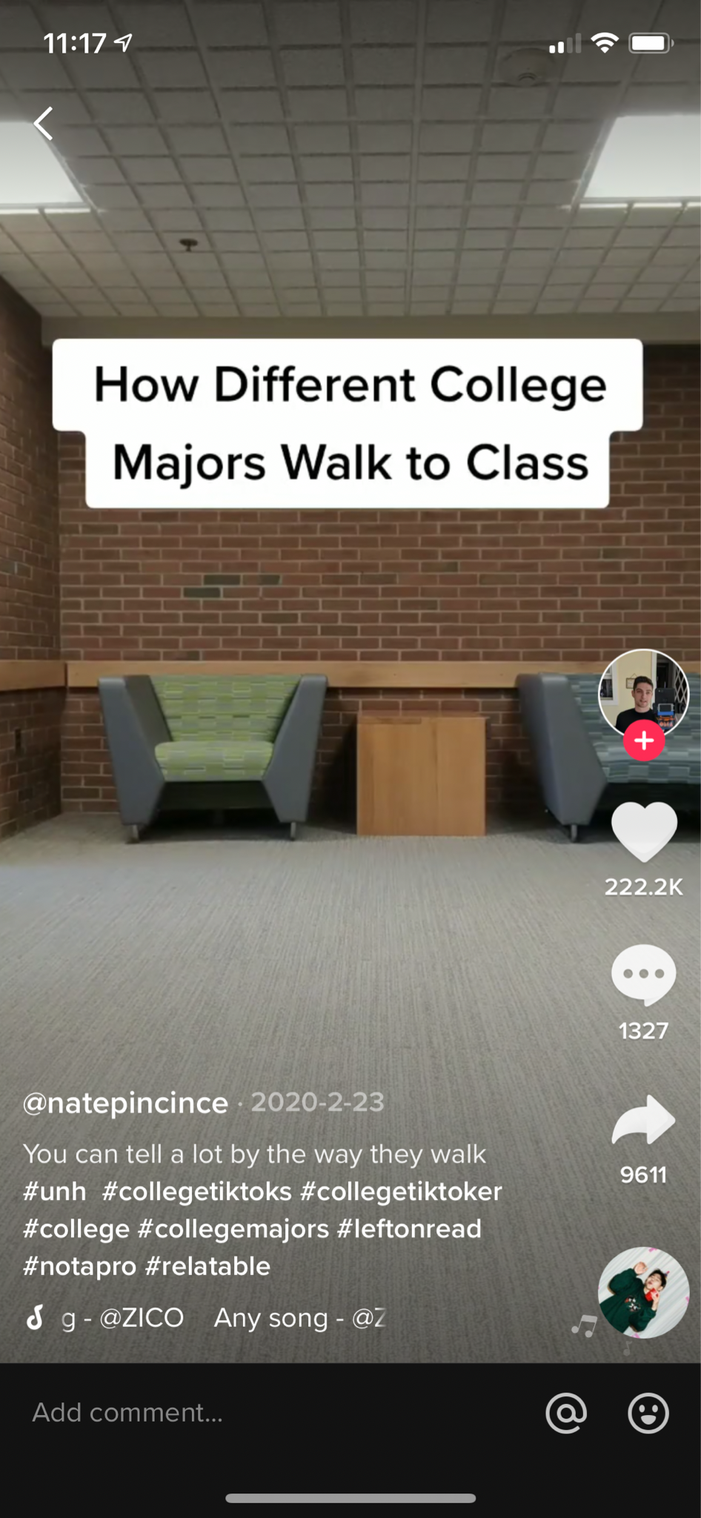
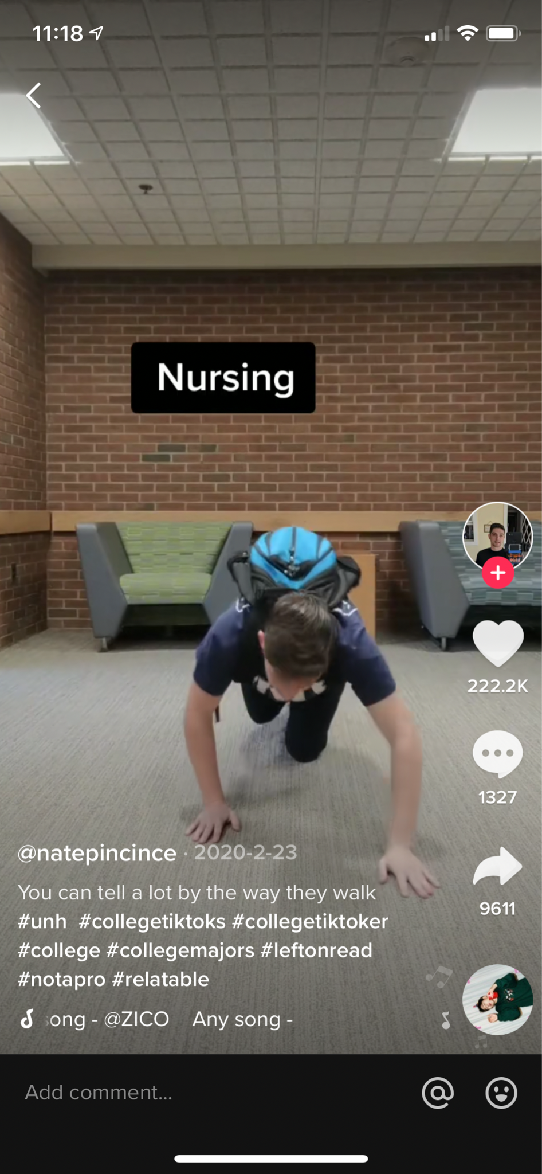
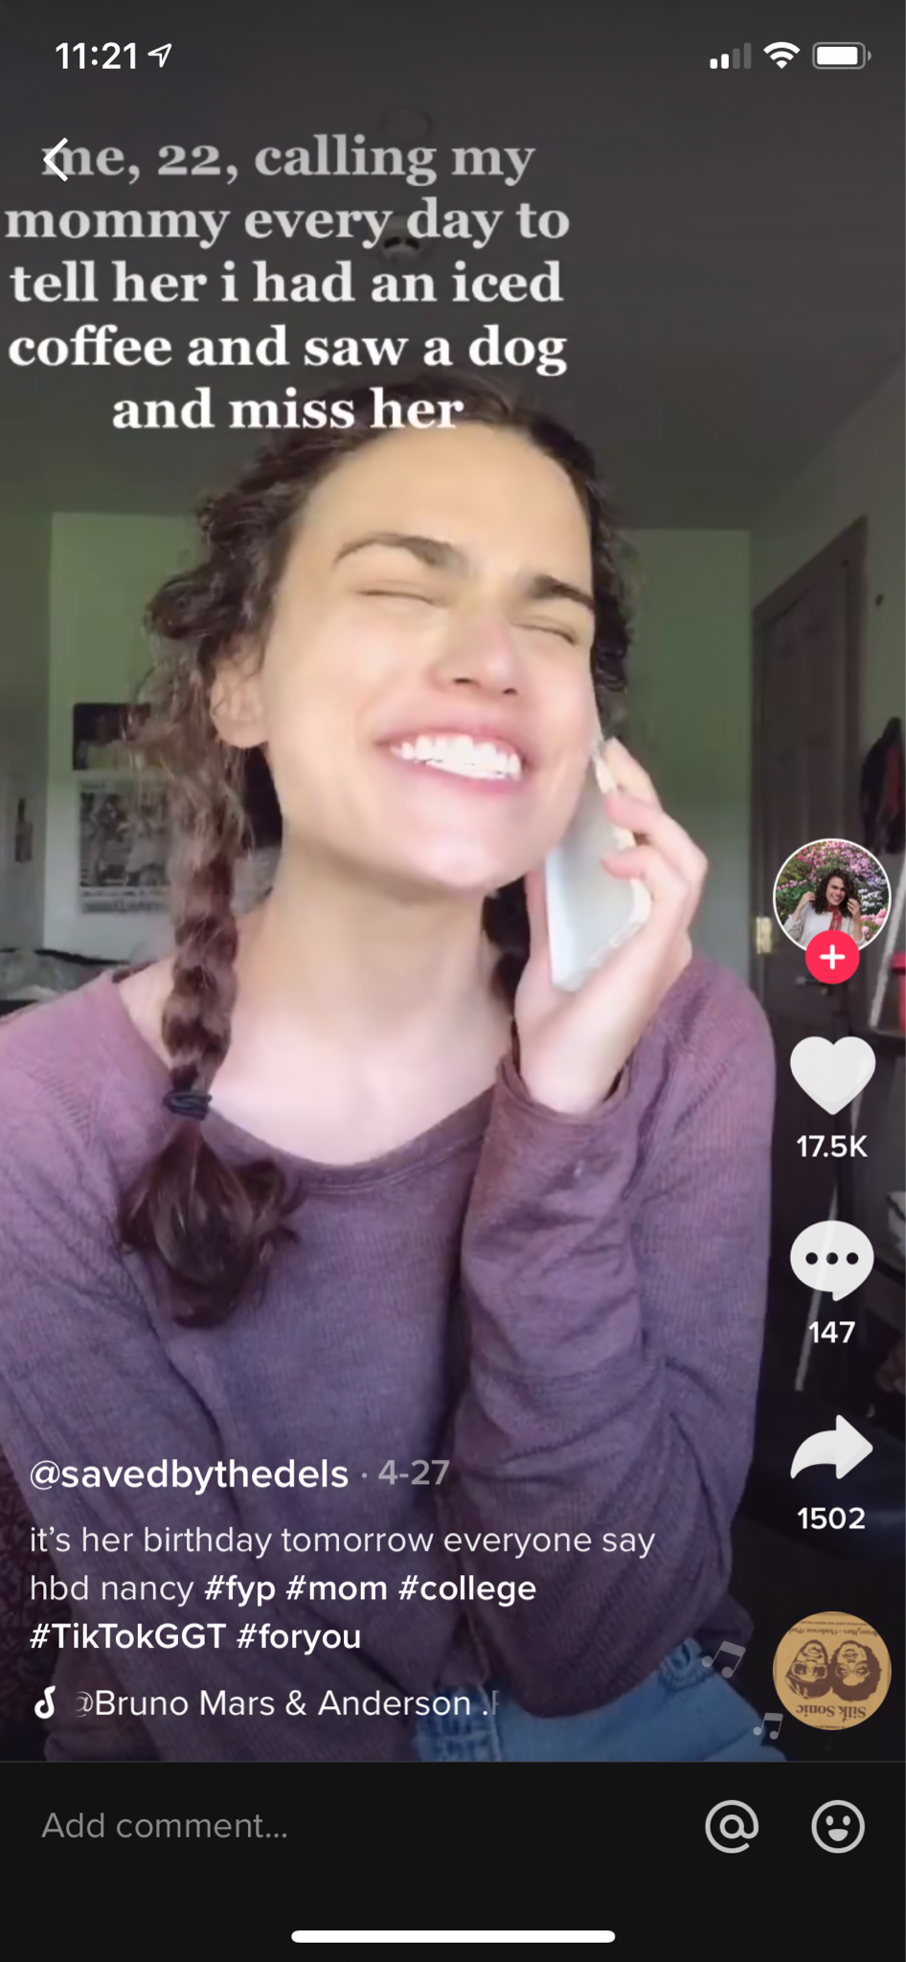
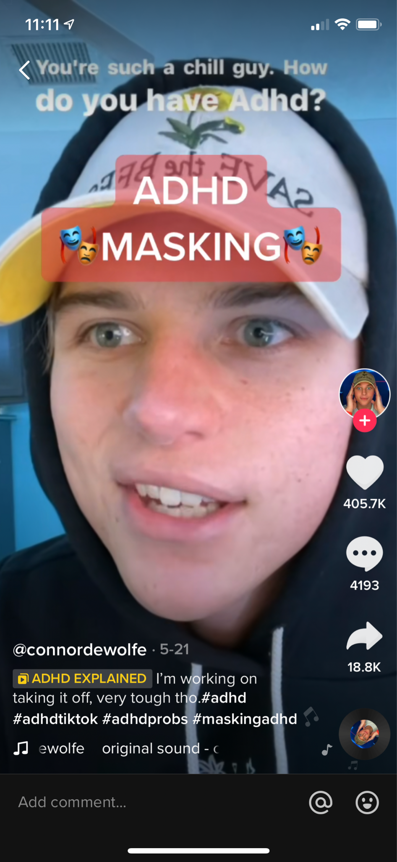
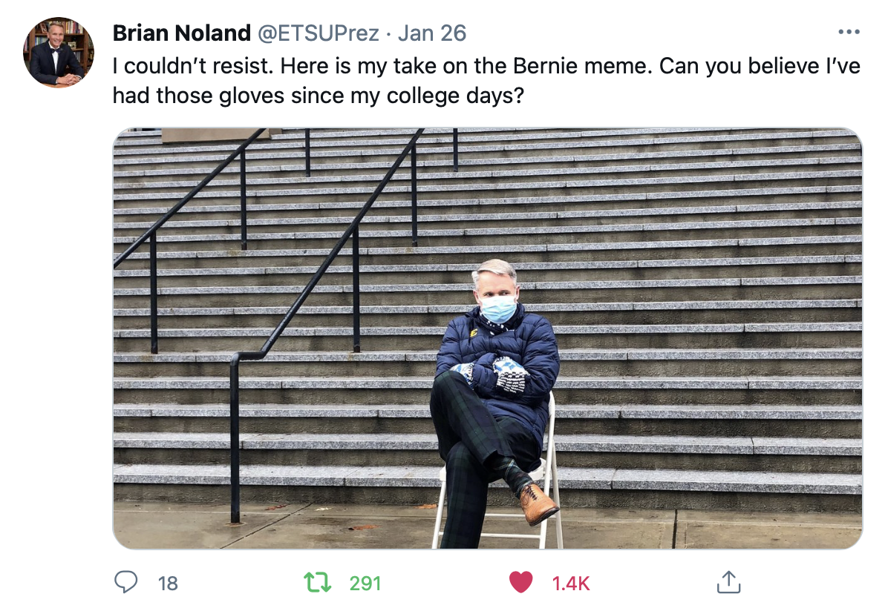
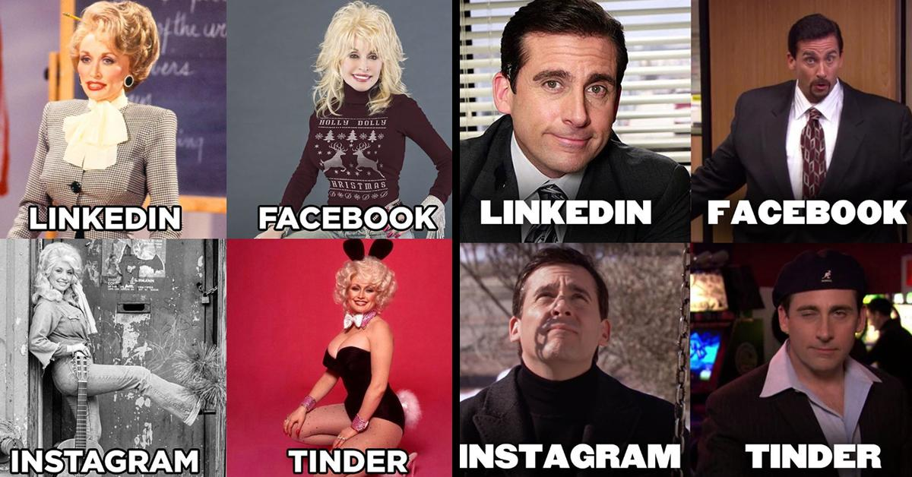
Focus on shared experiences.
Call out insecurities, irrational behaviors, or other human tendencies.
Empathize!
Notes:
How many of you have more than one social account you check daily? How many have more than 3?

Slide 22
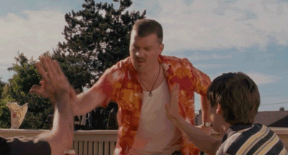
10. Inspire.
Notes:
How many of you have more than one social account you check daily? How many have more than 3?

Slide 23
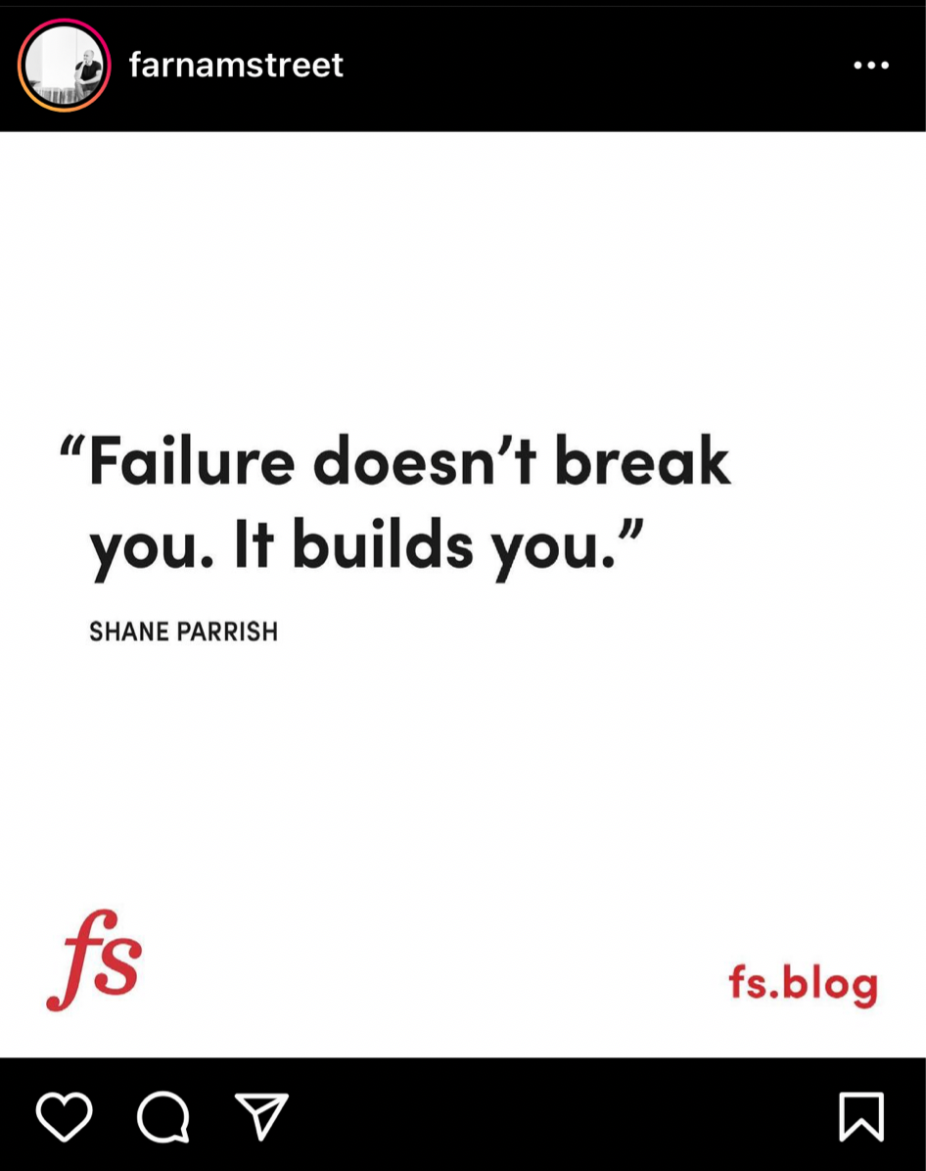
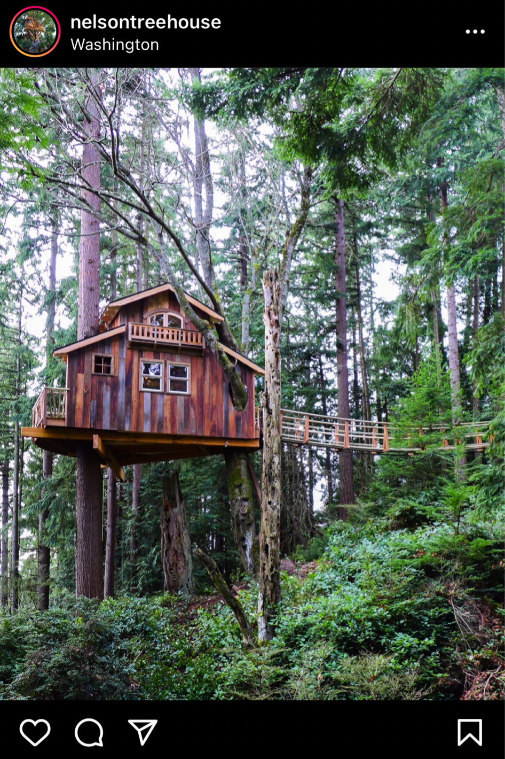
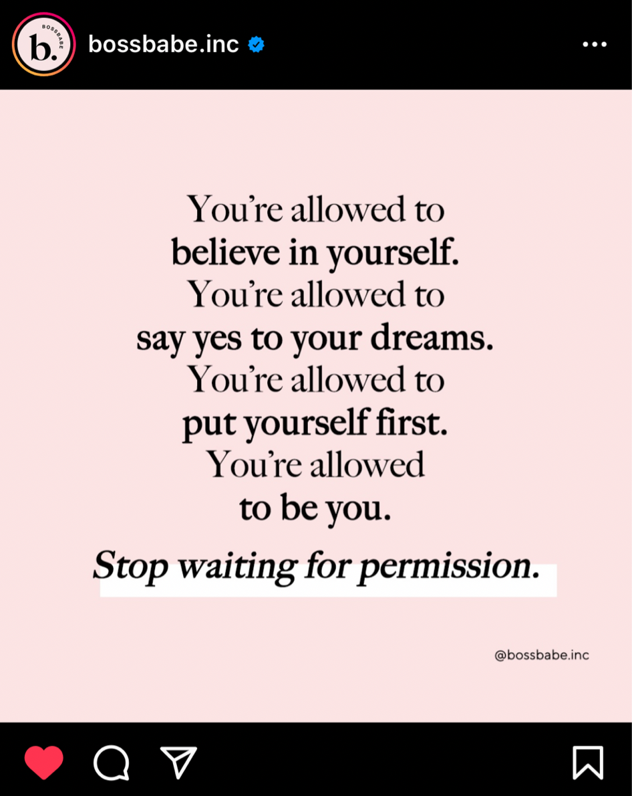
Focus on your mission
Offer encouragement
Offer examples
Set the vision
Notes:
How many of you have more than one social account you check daily? How many have more than 3?

Slide 24
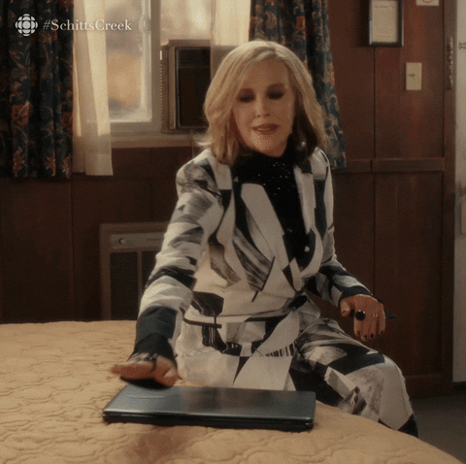
11. Invite.
Notes:
How many of you have more than one social account you check daily? How many have more than 3?

Slide 25
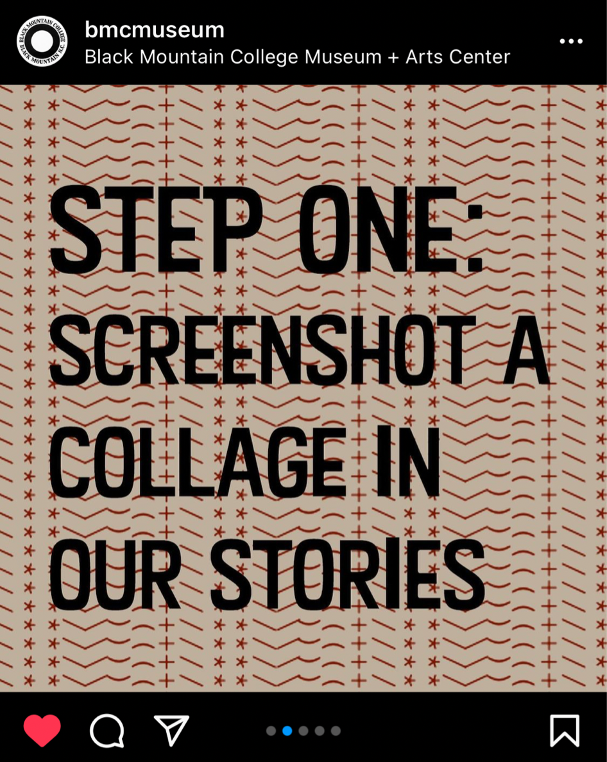
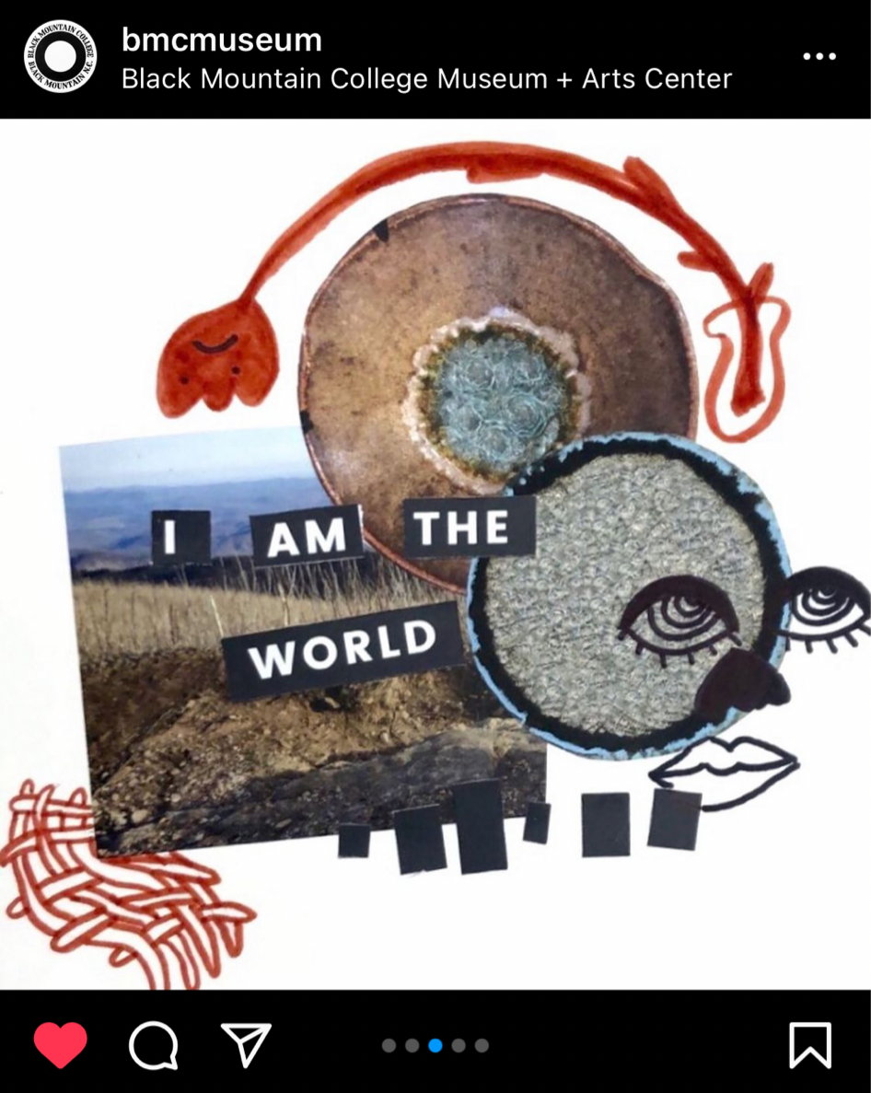
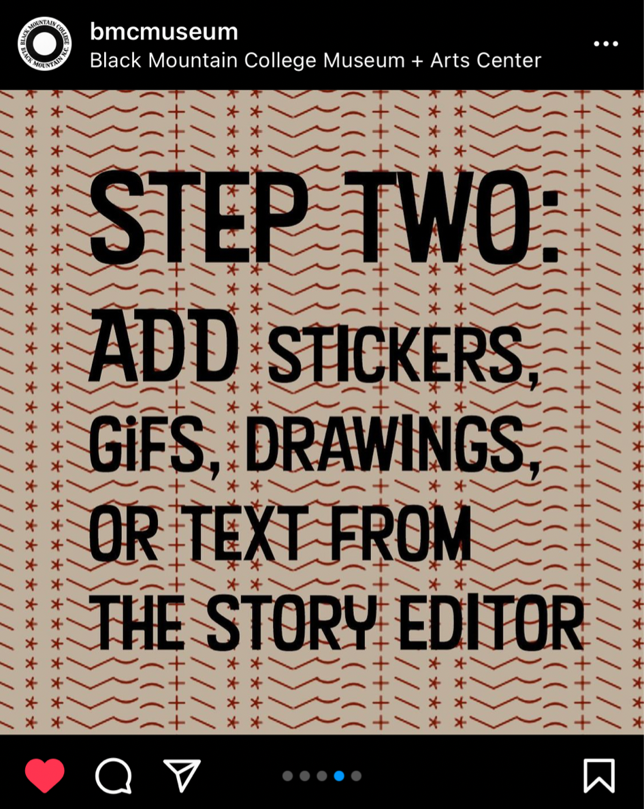
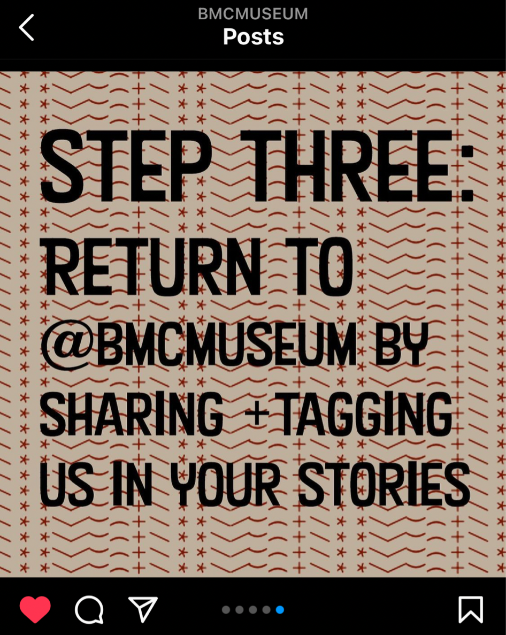
Issue explicit invitations.
Offer a framework for participation.
Build momentum by securing and sharing examples early.
Notes:
GoPro shot to stardom through user-generated content.
The company frequently hosts contests, and challenges based on a specific theme. Then it encourages content creators to share their photos and videos for a chance to earn products, cash, and global exposure through GoPro’s Instagram account—which has more than 17 million followers.
For instance, GoPro’s “Million Dollar Challenge” encourages participants to grab their HERO9 Black camera and film rad videos. Content creators with the best entries got a share of the $1 million allotted for the campaign.

Slide 26
Additional Resources & Ideas
14 Ways to Be More Transparent on Social Media
11 Killer User Generated Content Campaigns
31 Things to Post on Your Student Group’s Social Media Pages
Mastering Social Media for Clubs
If No One is Engaging with Your Marketing, You Should Do This
Social Media Marketing Tips for Every Platform

